Slide 2
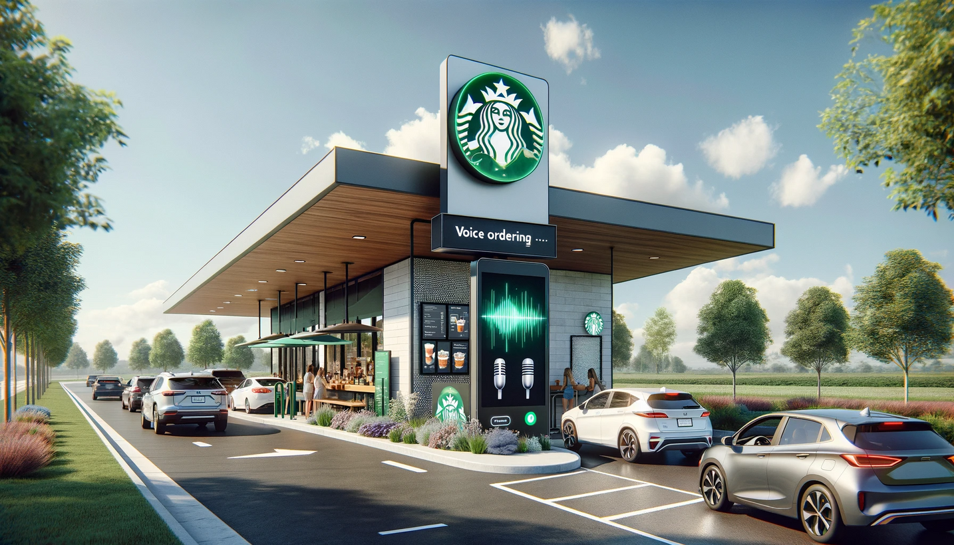

MBAN 6120 U – Data Science II
Starbucks
Voice-ordering Drive-Thrus
Presented by Group 10
Ananthu Hari (219878891)
Annuj Kamalesan (217044322)
Lifeng Liu (220089157)
Luyi Liu (220105474)
Rupali Wadhawan (220189445)
Xue Jin (220242129)

Slide 3
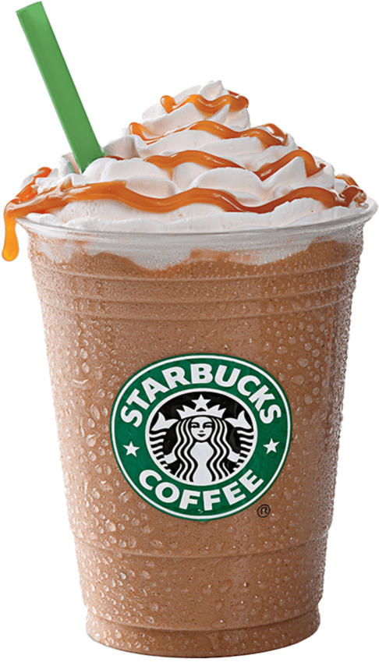
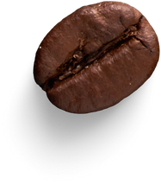

Introduction
Starbucks has consistently stood at the forefront of innovation and customer experience in the fast-paced world of coffee retail. Today, we are excited to present an opportunity to elevate this experience to new heights with our Natural Language Processing (NLP) model, specifically designed for Starbucks drive-thru kiosks.
Our technology promises to transform how customers interact with Starbucks, offering a seamless, efficient, and personalized ordering process. By integrating voice ordering capabilities, we aim to enhance customer convenience, reduce wait times, and ensure order accuracy, thereby reinforcing Starbucks' commitment to exceptional service and technological advancement.
Starbucks needs to tackle both cost savings and store expansion through drive-through stores. Utilizing machine learning to automate the voice ordering process within drive-throughs provides them a competitive advantage while strengthening the two priorities of cost savings and store expansion from their Triple Shot Reinvention Plan.

Slide 4


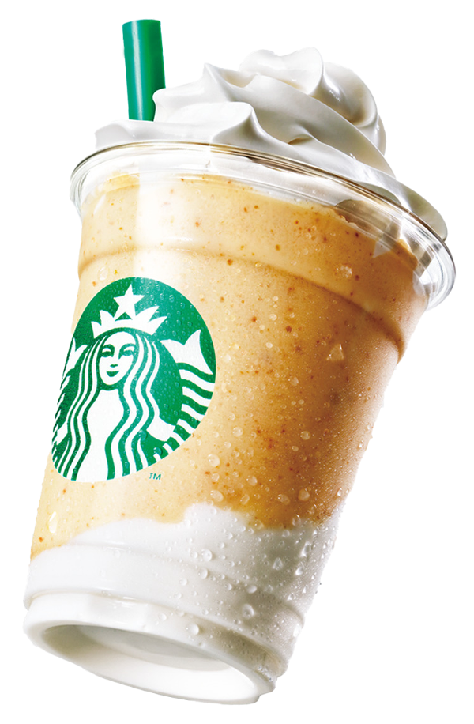
Deep Brew
Background
Launched in 2019
Starbucks’ innovative AI platform acts as an invisible, super-smart sidekick to the human baristas, helping do the heavy lifting with inventory, supply chain logistics, and replenishment orders, saving partners time, predicting staffing needs, and making schedules.
About Starbucks’ ML capabilities
Enhancing Customer Experience with AI
Operational Efficiency through AI
Data-Driven Decision Making
Voice Ordering on the App
Starbucks introduced voice ordering in its iOS app and Amazon Alexa in 2017, but the feature is still not fully implemented in its system. This initial rollout is part of the My Starbucks® barista functionality, enabling select customers to order coffee using voice commands.

Slide 5
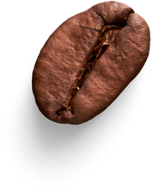
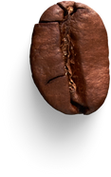


SWOT Analysis
In-store sales are declining (only 28% of customers place orders with baristas).
High real estate costs are impacting profitability.
$3 billion cost savings through machine learning for efficiency.
Accelerate store expansion to 55,000 globally by 2030, focusing on purpose-driven stores like drive-thrus.
W
O
Strong digital presence with 75 million Starbucks Rewards Members.
Operational efficiency through machine learning for supply chain and inventory.
Technological challenges in implementing machine learning.
Intense competition in the coffee and retail industry.
S
T

Slide 6



Data Collection
Audio
Noise Reduction, Filtering and Normalization
Tokenization and Removal of Stop Words
Transcribed Text
Product and Inventory
Data Preprocessing

Slide 7
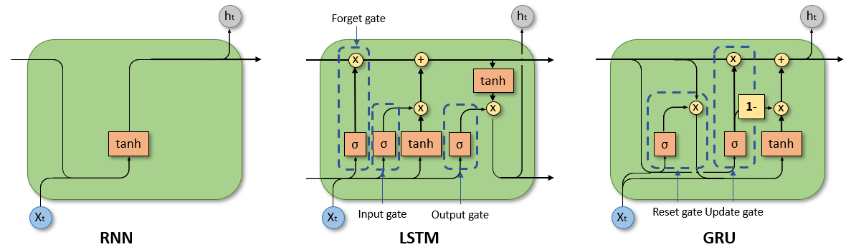
Model Selection
For our voice ordering app, we prioritize accurately capturing and processing lengthy speech sequences. While Recurrent Neural Networks (RNNs) are generally adept at handling sequential data like speech, they often falter with long-range dependencies due to the vanishing gradient problem. This limitation means they might lose context in longer sequences.
To address this, we've chosen Long Short-Term Memory Networks (LSTMs), an advanced RNN variant. LSTMs are equipped with unique mechanisms (input, output, and forget gates) within their LSTM cells, enabling them to maintain context and remember information over extended sequences. This capability makes LSTMs ideal for understanding and processing our application's complete spoken sentences or commands, ensuring higher accuracy and effectiveness in voice recognition tasks.

Slide 8
Other advantages of LSTMs for ASR
Strong in handling variability in speech
Noise and Error tolerance
Integration with other NN architectures
Efficiency in Training
However, training a bespoke model for a non tech company is cumbersome. There are plenty of out of box models that are available, that can handle Automatic Speech Recognition really well.
The introduction of LLM’s is a game changer for the industry.

Slide 9
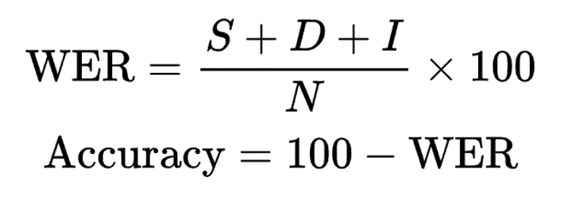

Evaluation of Models
Word Error Rate
Primary Accuracy metric used to evaluate ASR systems
Minimizes Levenshstein distance between two texts.
S – Substitutions, I – Insertions and D - Deletions
Proportion of total number of errors over the number of words in reference
Misspellings and repeated words are penalised as heavily as misinformation
NER
N – Number of Words, E – Sum of Edition Error Penalties, R – Sum of Recognition Error Penalties
Minor Error – 0.25 (Can easily read through the problem)
Standard – 0.5 (Disrupts the flow)
Serious – 1 (Drastic change in meaning)
Latency

Slide 10
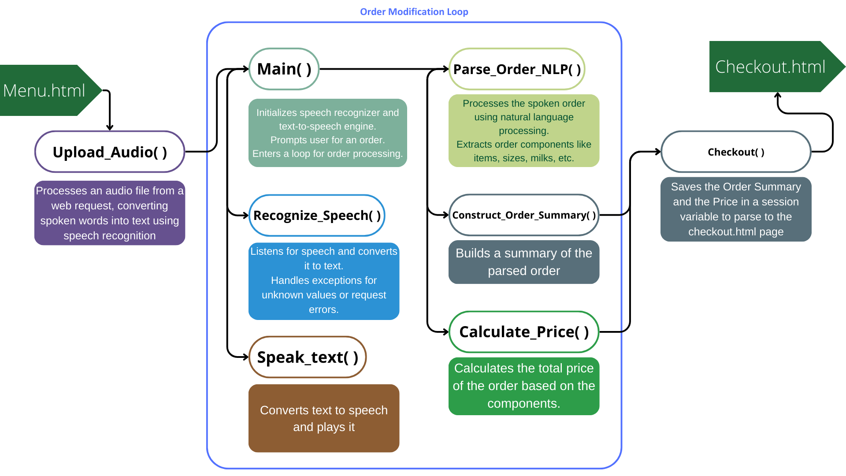
Functional Workflow

Slide 11
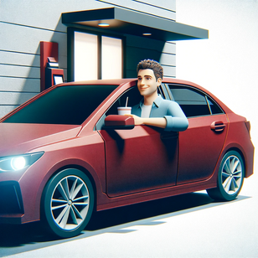

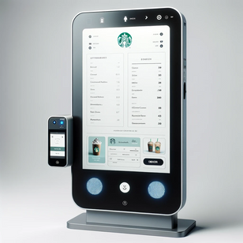
Product Architecture
Frontend layer
Backend Layer
Database Layer
Drive-thru Kiosk
with voice-ordering capability
Flask Backend Server
End-user
Web UI
Python functions to handle voice recognition
HTML
CSS
JavaScript
Menu Database
Python code with NLP models

Slide 12



Slide 13
Business Case
The Strategic Alignment
Automated Drive-Thru Order Taking
Our model streamlines the ordering process at drive-thrus, leading to significant time savings. This automation allows employees to dedicate more time to crafting high-quality beverages, enhancing overall operational efficiency.
Starbucks Triple Shot Reinvention Strategy for 2030 has 5 goals.
We want to focus on 2 of the major ones
$3 billion dollar goal to become more efficient
Enhanced Customer Experience and Sales Opportunities
To expand through purpose-driven stores particularly in drive-thru stores
The model supports multi-language ordering and integrates seamlessly with Starbucks' loyalty program. Additionally, it opens new avenues for increasing ticket sizes through targeted, data-driven promotions of new menu items, enriching the overall customer experience.

Slide 14
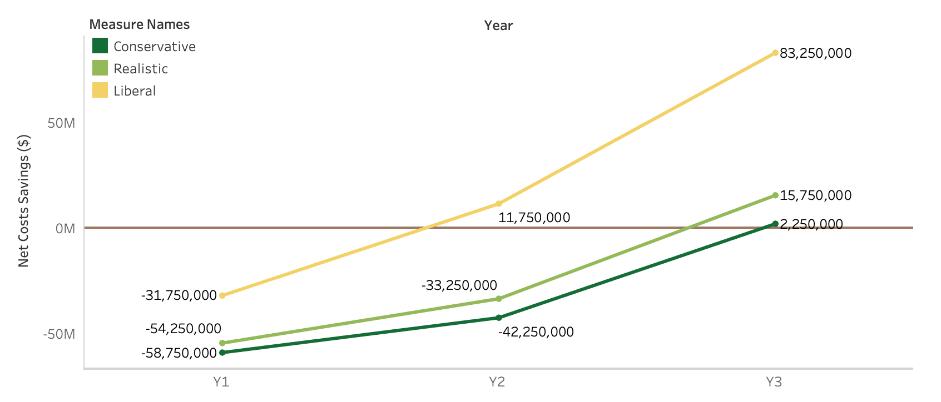
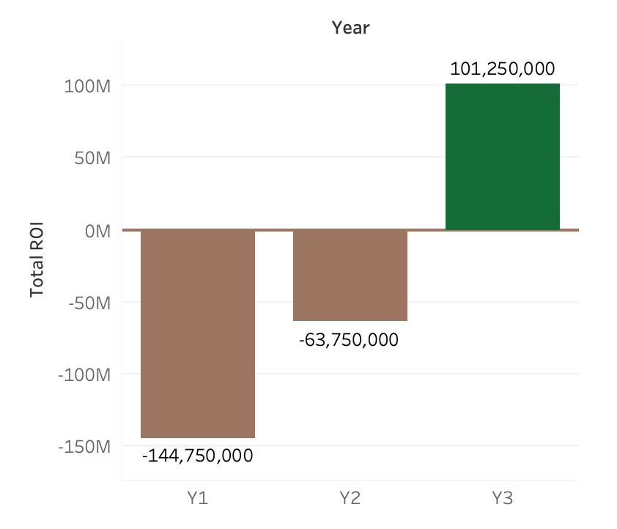
Business Case
Projected Numbers
By automating simple tasks, we aim to reduce barista shifts by less than half per store, leveraging the average salary of ~$35,000; this approach leads to significant cost savings and a break-even point by Year 3.
Setup costs include initial development, hardware, training security measures, cloud storage costs, maintenance, marketing, & legal
Automation in new store openings results in lower initial hiring costs, thus achieving incremental cost savings for each additional store.
Total ROI by year 3 will be about ~$101M

Slide 15
Risks and Mitigation
Risk | Mitigation
Customers prefer human ordering, leading to less cost savings as tasks are not fully automated | Accounted for in ROI projections with an opt-out budget and conservative estimates
Data ethics and Privacy might cause customers not to choose Starbucks and impact implementation | Marketing Budget created to thoroughly educate customers and Legal Budget to ensure regulatory compliance in each geography
Model Complexity causes performance issues due to unique combination of menu options and languages | Thorough testing of the model with a staggered in-store implementation to catch issues real-time
Franchisee concerns about the cost to their business and implementation | Create a thorough training program to educate franchisees along with employees while emphasizing cost savings and customer adoption
Probability
1
2
4
2
Low
Medium
High
1
3
3
4
Impact
Low
Medium
High

Slide 16





Future Enhancements
Expand the system's capabilities to include multiple languages, enhancing accessibility for non-English speaking customers.
Enhanced multilingual support
Personalization and Learning Algorithms
Implement machine learning algorithms to learn from customer preferences and order history, enabling personalized recommendations and quicker order processing.
Use data analytics to gain insights into customer preferences and operational efficiency. Implement a feedback system in the kiosk for immediate customer reviews.
Feedback Collection
Ensure the system is accessible to customers with disabilities by incorporating features like voice commands for visually impaired users and on-screen sign language for the hearing impaired.
Accessibility Features

Slide 17
Conclusion
Opportunity
Identification
Model
Selection
Business Case Development
Chosen Model: LSTM networks for sequential data handling.
Benefits: Addresses vanishing gradient and maintains context.
Evaluation Metrics: Word Error Rate, NER, Response Time.
Costs: Development, hardware, training, security, maintenance.
ROI: Anticipated break-even by Year 3, $101M ROI.
Risks & Mitigation: Customer adoption, privacy concerns, model complexity.
Enhance customer service through NLP in the drive-thru.
Address service speed and personalized experience.
ML as a solution for operational efficiency and customer satisfaction.
Strategic Outlook:
Aligns with Starbucks Triple Shot Reinvention Strategy.
Targets $3 billion efficiency goal and drive-thru store expansion.

Slide 18
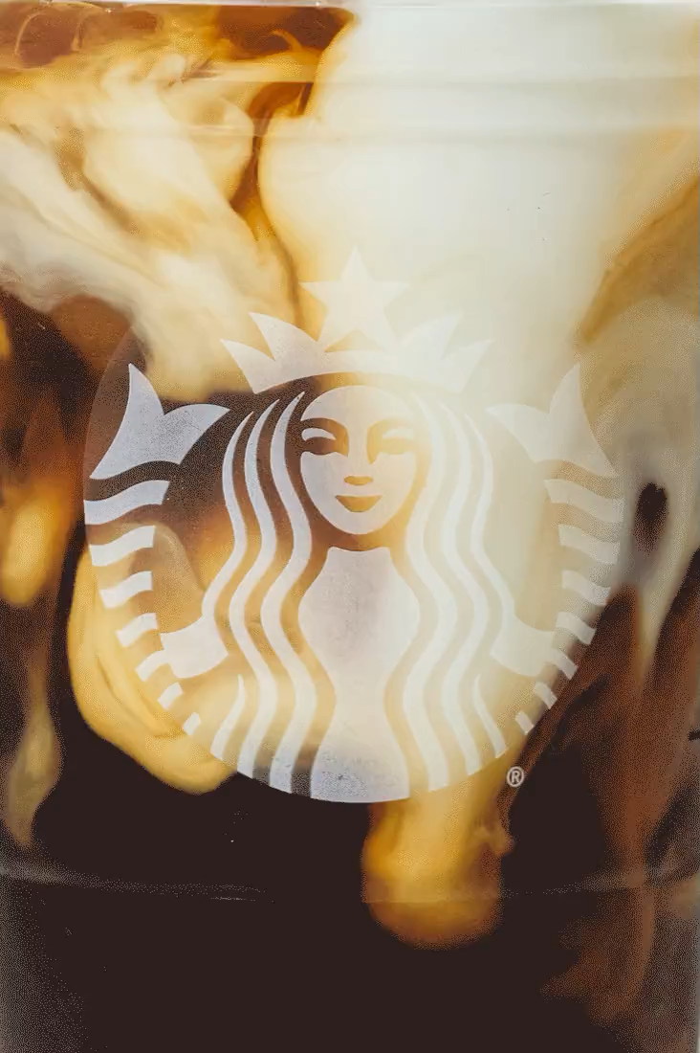
Thank you!

Slide 19
References
Starbucks Debuts Voice Ordering. (2017, January 30). Starbucks Stories. Retrieved November 28, 2023, from https://stories.starbucks.com/press/2017/starbucks-debuts-voice-ordering/
Starbucks Announces Triple Shot Reinvention Strategy with Multiple Paths for Long-Term Growth. (2023, November 2). Starbucks Stories. Retrieved November 28, 2023, from https://stories.starbucks.com/press/2023/starbucks-announces-triple-shot-reinvention-strategy-with-multiple-paths-for-long-term-growth/
Meisenzahl, M. (2022, August 6). Starbucks Is Embracing Drive-Thrus and Mobile Over Its Traditional Model. Business Insider. Retrieved November 28, 2023, from https://www.businessinsider.com/starbucks-embracing-drive-thrus-and-mobile-over-traditional-mode-2022-8

Slide 20
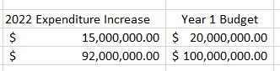
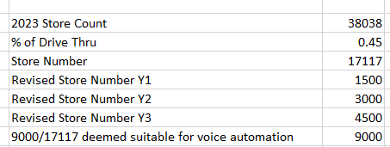
Appendix 1: Costs

Slide 21
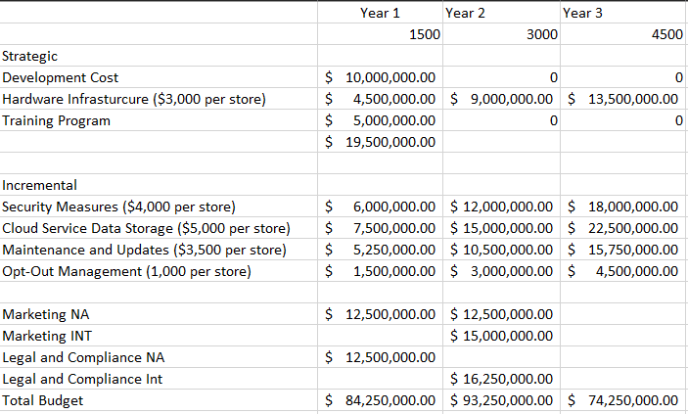
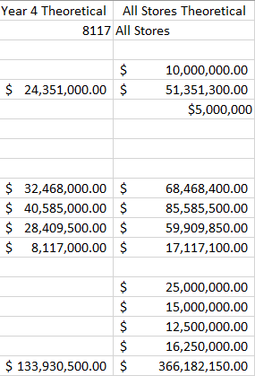
Appendix 1: Costs

Slide 22
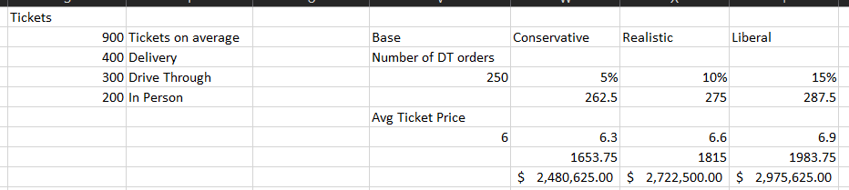
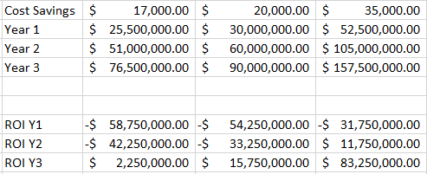
Appendix 1: Costs

Slide 23
Appendix 2: Code
https://github.com/rupaliwadhawan1/schulich_data_science/tree/main/DS2_Group_Project_Starbucks

